Slide 1

PROJECT REVIEW PRESENTATION
ARQUO
Think before pixels.
An AI-assisted workspace for exploring and shaping multi-screen UI concepts from natural-language prompts.
PROJECT TEAM
Amirtha Rengavathi
Bhavana
241701005
241701009
ARQUO • DESIGN WORKSPACE PROTOTYPE
Notes:
Opening: Introduce ARQUO and the project team. Frame this as a review of the current design-workspace prototype.

Slide 2
ARQUO
The Problem
Turning an idea into a coherent interface takes more than a prompt.
01
Unstructured starting point
02
Disconnected design steps
Ideas often begin as loose descriptions, not usable interface briefs.
Planning screens, user flows and UX decisions can happen in separate tools.
03
Slow early iteration
04
Limited design guidance
Moving from a concept to something visual enough to review takes repeated effort.
Users may need help thinking through personas, structure and usability.
The gap is between knowing what to build and knowing how to shape the experience.
ARQUO / PROJECT REVIEW
02
Notes:
Problem: Explain the four friction points. Emphasize that ARQUO focuses on helping users move from an idea to a visual, reviewable starting point.

Slide 3
ARQUO
Why this matters
The cost of fragmented early design is paid in clarity, time and iteration.
FOR THE CREATOR
FOR THE DESIGN PROCESS
•
Harder to translate intent into screens
•
Ideas, flows and UI concepts become disconnected
•
More manual work before feedback is possible
•
Review starts later because there is less to react to
•
UX decisions feel difficult to structure
•
Iteration can become repetitive and inconsistent
Motive: make the first design step more guided, visual and easier to refine.
ARQUO / PROJECT REVIEW
03
Notes:
Motivation: Describe the user and process impact qualitatively. No unsupported market statistics are claimed.

Slide 4
ARQUO
THE CORE IDEA
Not just a canvas.
A guided design workspace.
ARQUO brings prompt-led generation, UX exploration and multi-screen editing into one visual environment — helping users move from a product brief to a concept they can inspect and refine.
Describe → Explore → Generate → Review
ARQUO / PROJECT REVIEW
04
Notes:
Core insight: Position ARQUO as a unified workspace. The key distinction is the combination of prompt input, UX-oriented actions, and a multi-screen canvas.

Slide 5
ARQUO
How ARQUO
Works
01
02
Describe the idea
Explore UX context
A user starts with a brief. ARQUO provides a workspace to explore the idea, create screens and refine the direction.
Enter a natural-language prompt describing the product and its users.
Use Persona, User Flow and Analyze UX to think through the experience.
03
04
Generate UI
Review & refine
Create a multi-screen concept and view it on the design canvas.
Navigate screens, inspect layers, switch to wireframe and export.
ARQUO / PROJECT REVIEW
05
Notes:
How it works: Walk through prompt, UX exploration, UI generation, and review. Distinguish visible controls from features whose full end-to-end behavior may still need testing.

Slide 6
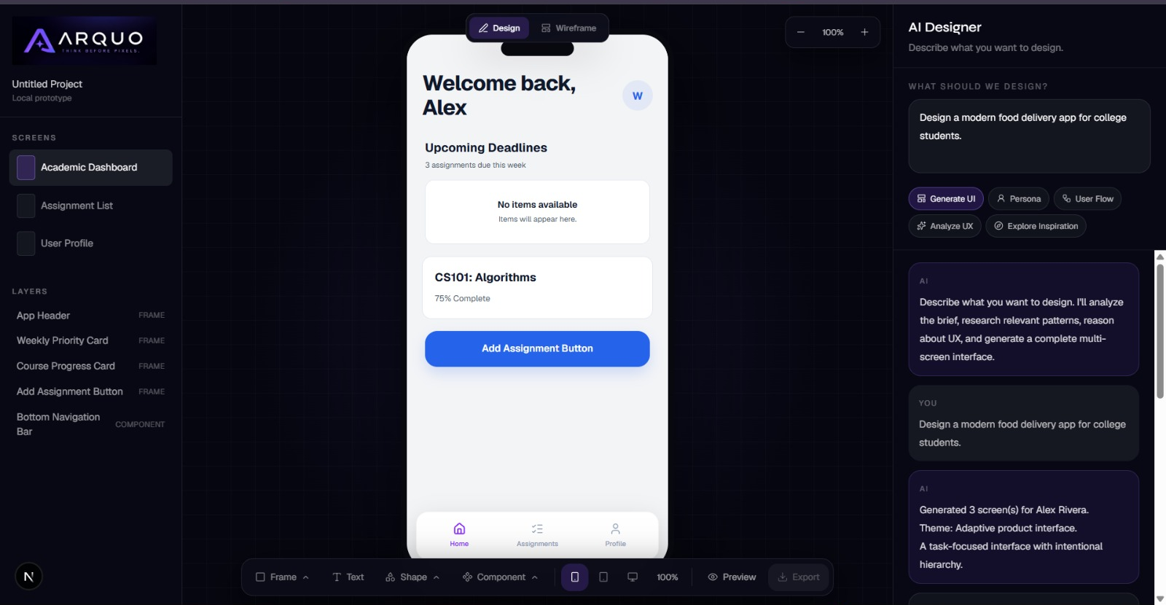
ARQUO
A workspace built around the design process
Generate UI
Prompt-based multi-screen concept creation
Persona
Explore the intended user
User Flow
Map key journey steps
Analyze UX
Review structure and usability
Explore Inspiration
Find visual direction and references
Design / Wireframe
Switch between visual design and wireframe views
Screens & Layers
Navigate screens and inspect interface components
ARQUO / PROJECT REVIEW
06
Notes:
Features: Point to the actual interface screenshot. Explain the visible AI Designer actions and workspace controls. Phrase them as capabilities exposed by the prototype; avoid asserting that each action has been fully validated.

Slide 7
ARQUO
A multi-screen design, in one place
The prototype example shows an academic productivity app concept.
THREE SCREENS IN THE EXAMPLE
01
Academic Dashboard
Deadlines, course progress and primary actions.
02
Assignment List
Search, tabs and assignment cards.
03
User Profile
Profile information and settings controls.
ARQUO turns an idea into a clearer first design direction.
Thank you • Questions
ARQUO / PROJECT REVIEW
07
Notes:
Closing: The captured prototype example shows three navigable screens: Academic Dashboard, Assignment List, and User Profile. Close by restating ARQUO's purpose. This is a project review deck; do not add a future validation/roadmap slide unless requested.

